Slide 1

ALY 6010
Final Project Presentation
Submitted by Bhagyashri, Krishna Vamsi.
Submitted to
Professor: Behzad Ahmadi

Slide 2
Final Project Overview Flow
Data Selection
1
Data cleaning
2
Exploratory Data Analysis
3
Hypothesis Testing
4
Linear Regression Model
5

Slide 3

INTRODUCTION
Cardekho is a online platform that helps users buy the right used car with below :
Used cars listing of cars sold from 1983 to 2020
Expert reviews
Detailed specifications of the used car
We implemented and learned the below in this Project :
Correlation plots - understand the relation between the attributes
Perform Uni-variate and Bi-variate analysis
Hypothesis Testing
Building a linear regression model.

Slide 4
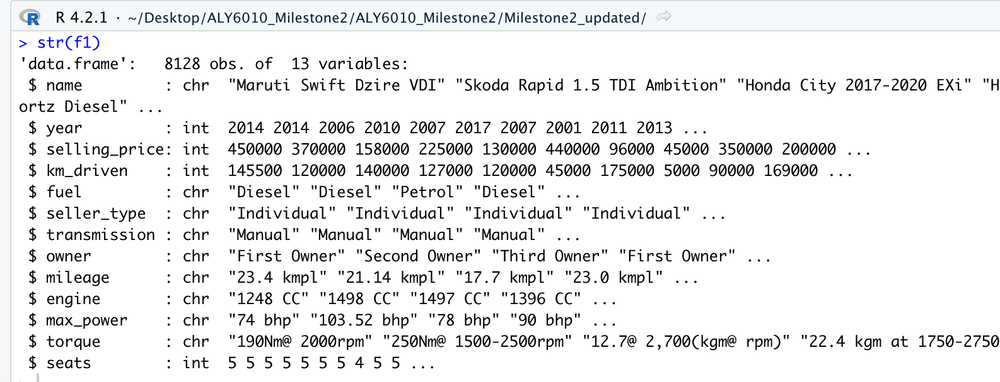
Used car Dataset Structure - Raw
8128 data points of 13 features

Slide 5
Data Cleaning
Removing kmpl , bhp & CC from Mileage , Max power and Engine
Extracting the Torque value and Rpm value
Extracting the Manufacturer & Model from the Name Column
Change Data type of Variables
Input missing values
Create new features

Slide 6
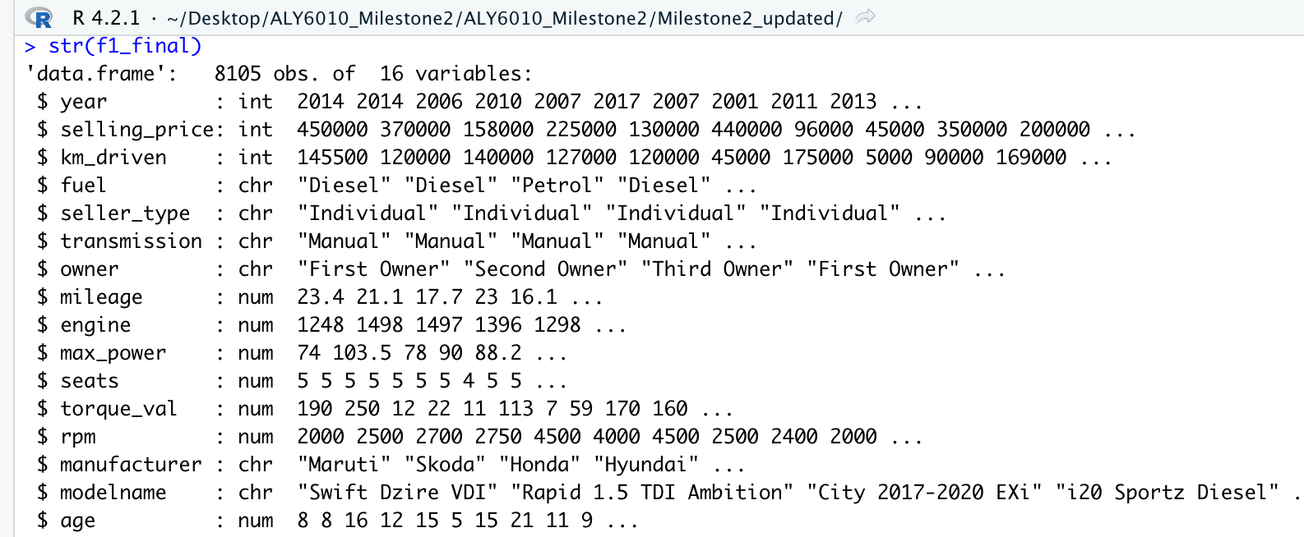
Cleaned Dataset Structure
01
New variable - Age Calculated based on the existing variable - Year
02
Extracted the Torque & Rpm value
03
Extracted the Model and Manufacturer Name from existing Name Column
04
Dropped the Original Columns as not required
Final Cleaned dataset - 8105 data points of 16 features

Slide 7
Cleaned Dataset - Numerical/Categorical Attributes
Selling price, Kms driven, Engine, Mileage
Numerical
Max power, Torque value , Rpm ,Seats , Age
Used Car Dataset
Fuel type , Seller Type , Owner
Categorical
Transmission , Manufacturer

Slide 8
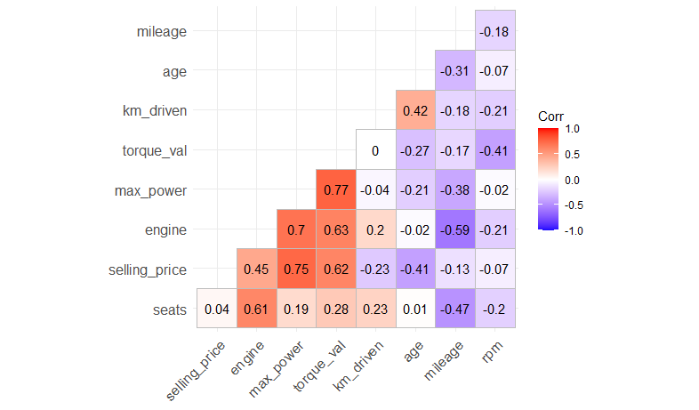
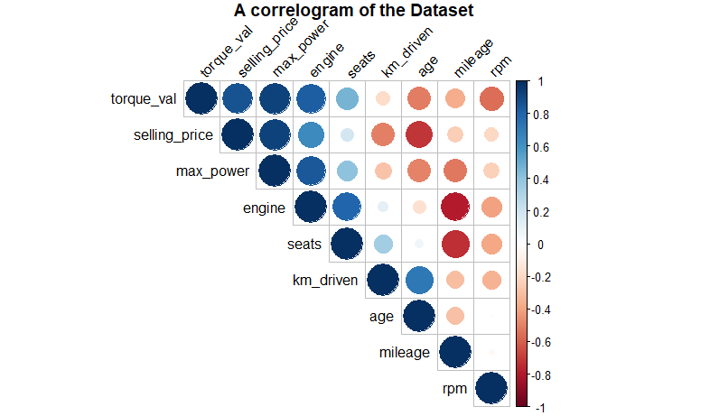
Correlation of the Numeric Features

Slide 9
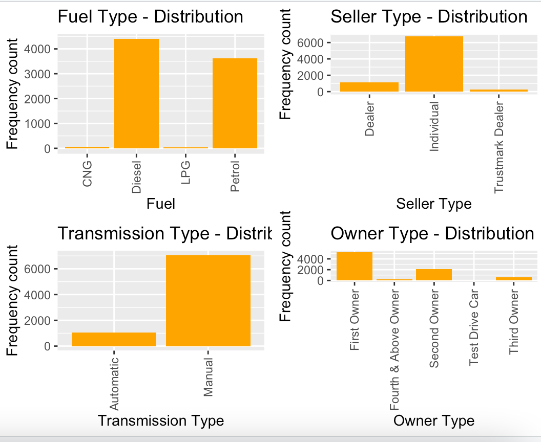
Distribution of data
There is not much in the distribution of Diesel & Petrol
Most of the cars in the dataset are sold by the Individual Seller type.
Majorly Manual cars were sold from the year 1983 to 2020
Cars sold by the first owner accounts for the majority of the data in the dataset.

Slide 10
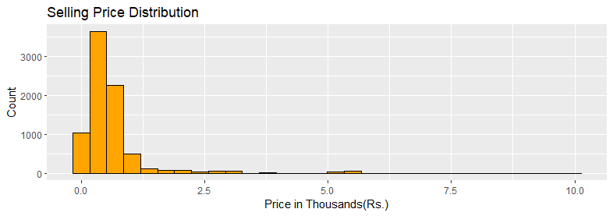
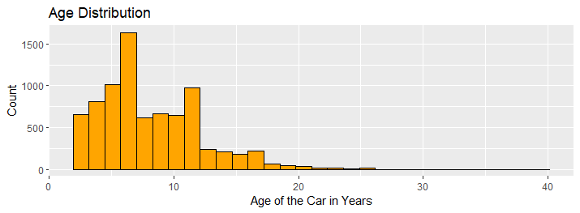
EDA : Univariate analysis
Most of the data for Selling Price is within the 2K range. This shows positive skewed distribution
Most data for the age of the cars within 10 years. This again the data is a right skewed distribution.
Notes:
Add age of the car histogram & Selling price of the histogram

Slide 11
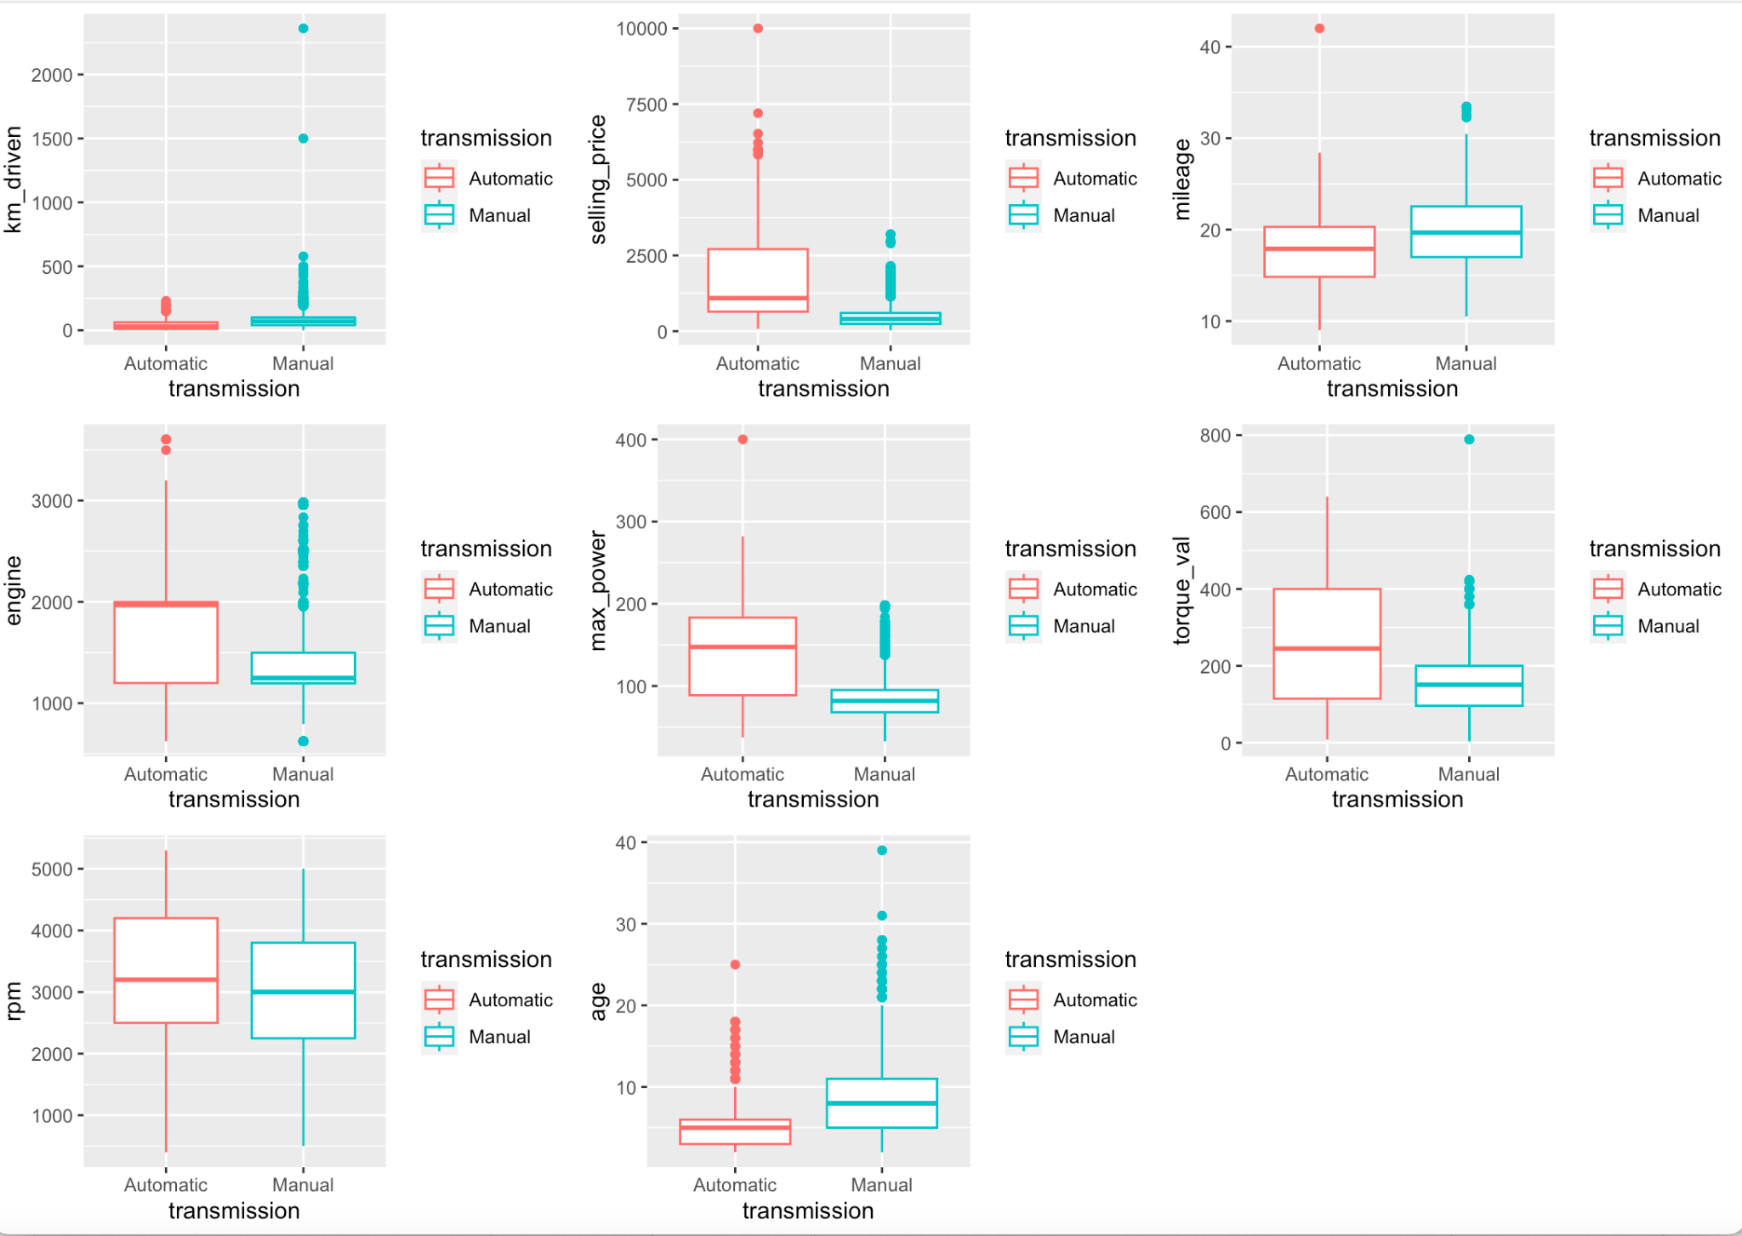
EDA : Univariate analysis
Box plots for all numerical attributes based on the Transmission type - Manual / Automatic
Rpm feature seems to be normally distributed with no presence of outliers
There is least no of outliers for Mileage and Torque value , otherwise the data is normally distributed

Slide 12
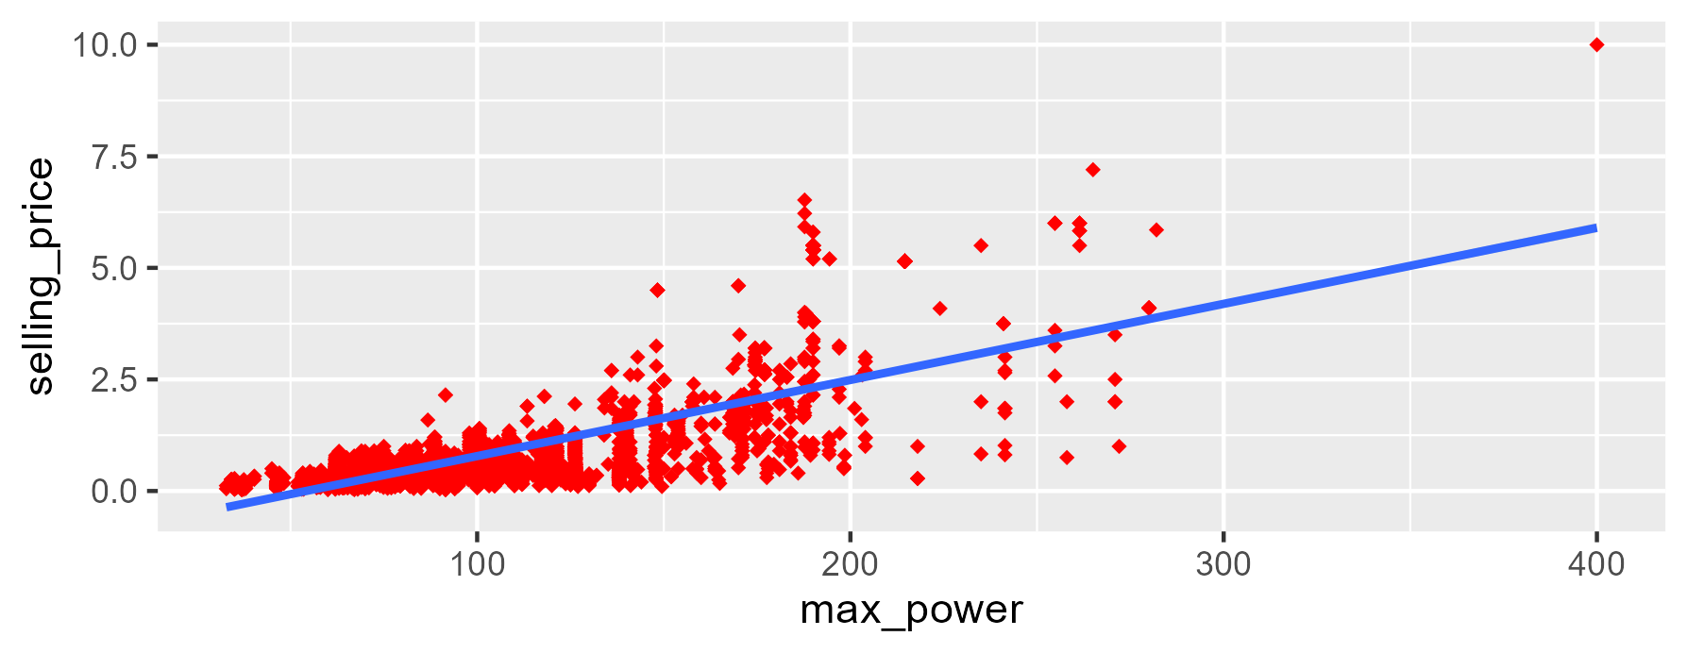
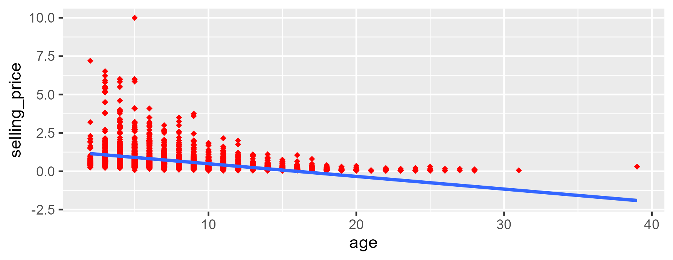
EDA : Bivariate analysis
Max power of the used car and selling price show a strong positive correlation , however for age we can observe there is a weak or negative correlation with the Selling Price

Slide 13
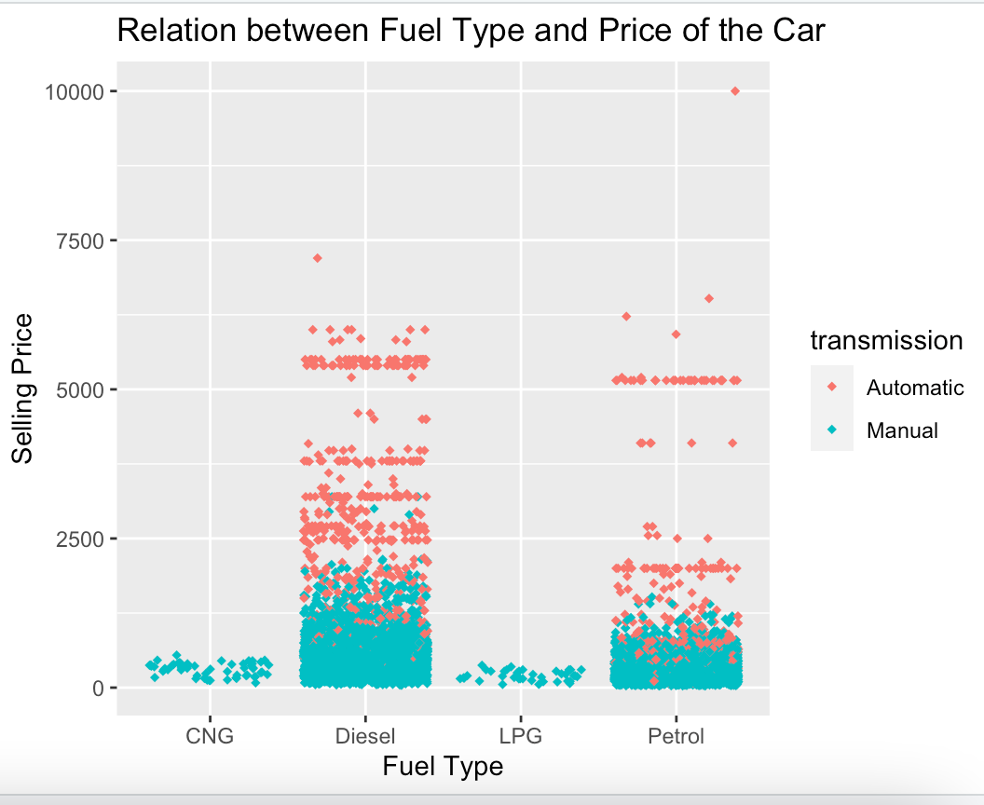
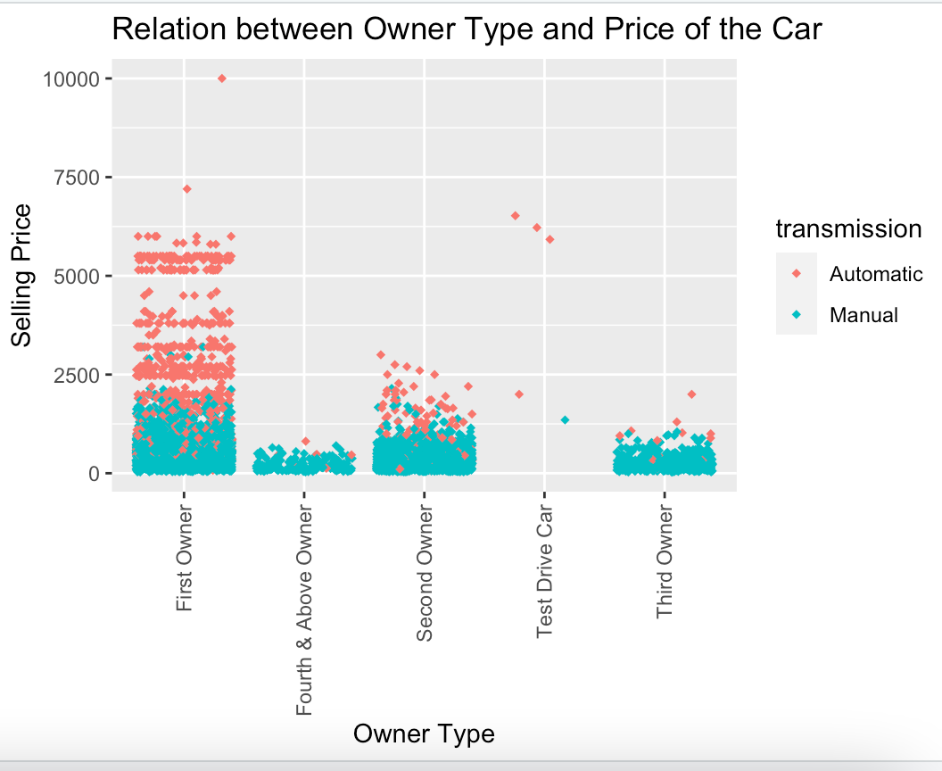
EDA:Bivariate analysis
Most of the Automatic cars are of Fuel type - Diesel .
Almost majority of the automatic cars were sold by the First owner

Slide 14
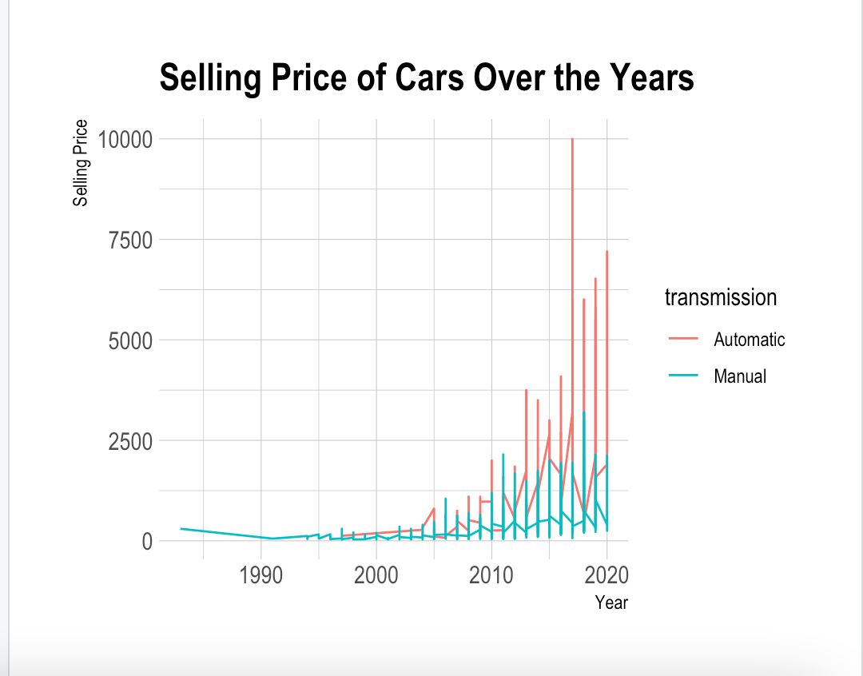
Yearly Price Trend
The number of cars sold from the years 1983 to 2000 were the least and most of them were Manual cars and within the selling price range of 1K.
We can see that after year 2005 , Automatic cars demand increased and surpassed the Manual cars .

Slide 15
Linear Regression Model - Results
In the Linear regression model we kept selling price as a dependent variable and variables like maxpower, torque, ownertype, kms driven etc as the independent variables.
With only Numerical attributes having strong correlation
Max power, torque value, engine
(r2)=57%
With best numerical + categorical
Max power, torque value,Rpm, kms driven, age, mileage, transmission, and manufacturer.
(r2)=85%
We understood that with the combination of Numerical and Categorical attributes,the 3rd Model looks the best fit as it can explain 85% variance in the the Selling Price variable

Slide 16
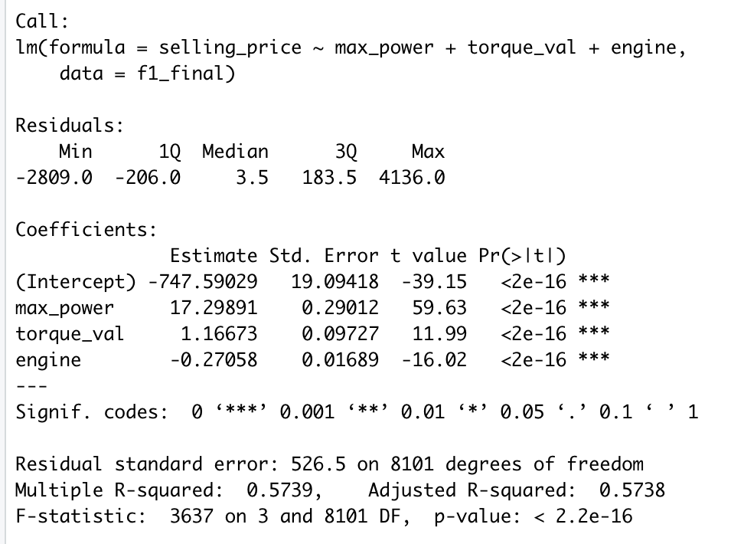
Model-1

Slide 17
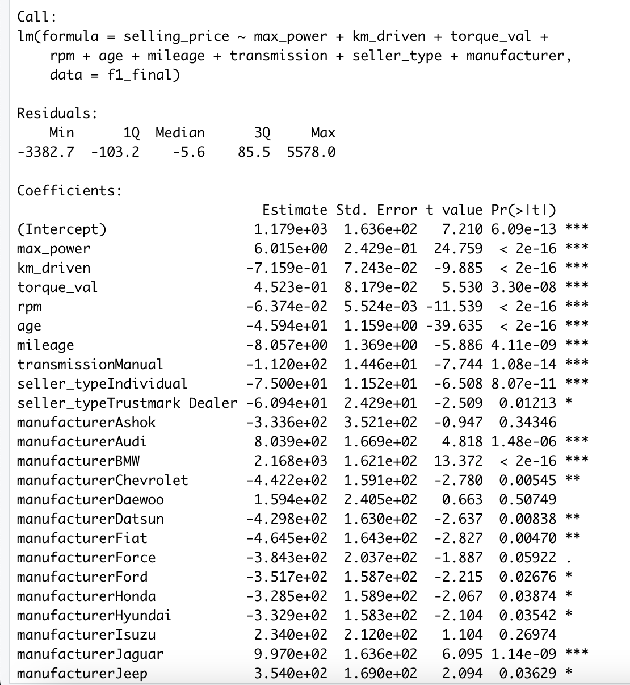
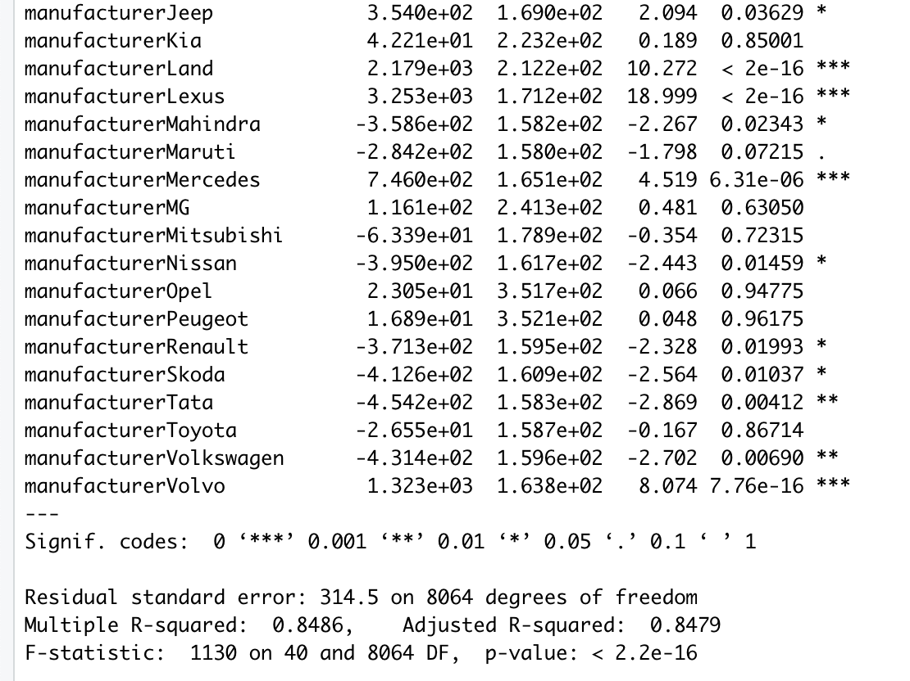
Model -2

Slide 18
Thank You!!

